Slide 1
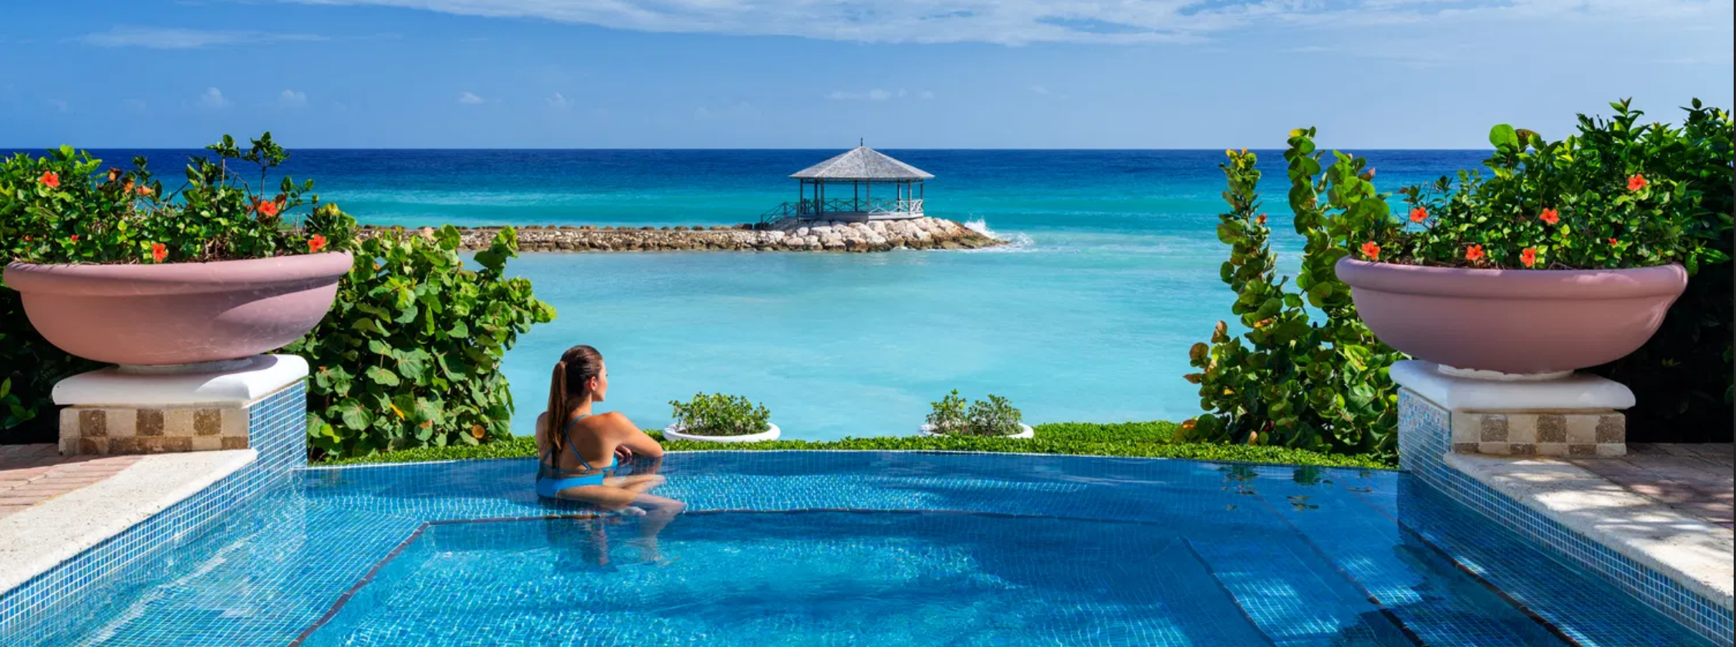
Hotel Management System
Team Structure
Duy Thai Nguyen – Implementation (Room module)
Truong Thanh Nam Nguyen - Implementation (Guest module)
Duy Hanh Nguyen – Implementation (Login, Role),
Quoc Nam Le – Design framework, Implementation (Booking, Check-in, Checkout)
Group - Design, Documentation, Review, Testing, Database Design

Slide 2
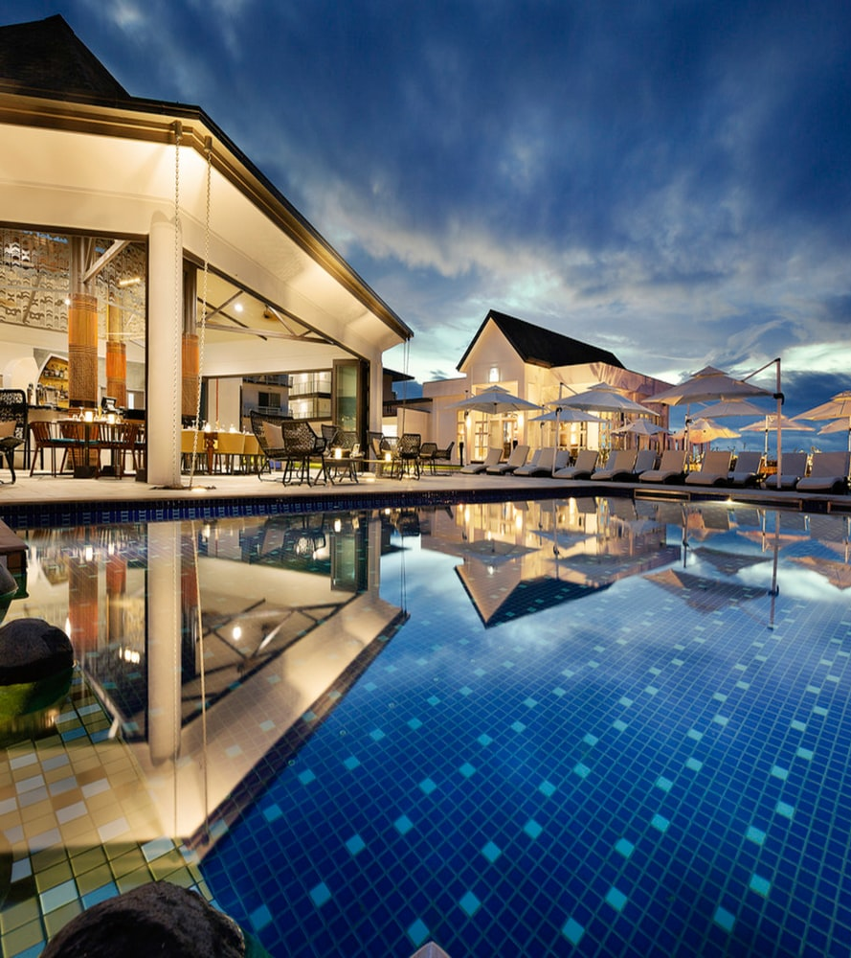
Contents
System Requirement
System Design
Class Diagram
Database Relationship
Sequence Diagrams
System Demo

Slide 3
Contents
System Requirement
System Design
Class Diagram
Database Relationship
Sequence Diagrams
System Demo

Slide 4
System Requirement
Problem Statement
There are two user roles in the system:
Staff
Administrator
Below is the functions that the system provides:
Administrator: create/edit Room
Staff: CRUD Guest, CRUD Reservation/Check-in/Check-out
Business needs
Each guest keeps list of Booking entry, and for each booking entry contains details as reservation, check-in, and check-out information
To access the system, user must login. Administrators are “add/remove” a room. But they are not allowed to create new Guest, add booking or booking details of Guest (unless they also have Staff role) . Only hotel staffs allow to add/edit booking, booking details, and add/edit Guest information and but not allowed to add/remove room (unless they also have Administrator role)
Notes:
QuickStarter has created an outline to help you get started on your presentation. Some slides include information here in the notes to provide additional topics for you to research.
Summary:
A hotel manager, hotelier, or lodging manager is a person who manages the operation of a hotel, motel, resort, or other lodging-related establishment. Management of a hotel operation includes, but is not limited to management of hotel staff, business management, upkeep and sanitary standards of hotel facilities, guest satisfaction and customer service, marketing management, sales management, revenue management, financial accounting, purchasing, and other functions. The title "hotel manager" or "hotelier" often refers to the hotel's General Manager who serves as a hotel's head executive, though their duties and responsibilities vary depending on the hotel's size, purpose, and expectations from ownership. The hotel's General Manager is often supported by subordinate department managers that are responsible for individual departments and key functions of the hotel operation.

Slide 5
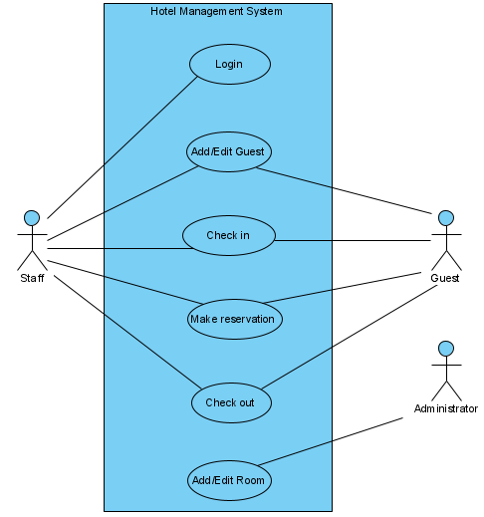
System Requirement
Use Case
Notes:
QuickStarter has created an outline to help you get started on your presentation. Some slides include information here in the notes to provide additional topics for you to research.
Summary:
A hotel manager, hotelier, or lodging manager is a person who manages the operation of a hotel, motel, resort, or other lodging-related establishment. Management of a hotel operation includes, but is not limited to management of hotel staff, business management, upkeep and sanitary standards of hotel facilities, guest satisfaction and customer service, marketing management, sales management, revenue management, financial accounting, purchasing, and other functions. The title "hotel manager" or "hotelier" often refers to the hotel's General Manager who serves as a hotel's head executive, though their duties and responsibilities vary depending on the hotel's size, purpose, and expectations from ownership. The hotel's General Manager is often supported by subordinate department managers that are responsible for individual departments and key functions of the hotel operation.

Slide 6
Contents
System Requirement
System Design
Class Diagram
Database Relationship
Sequence Diagrams
System Demo

Slide 7
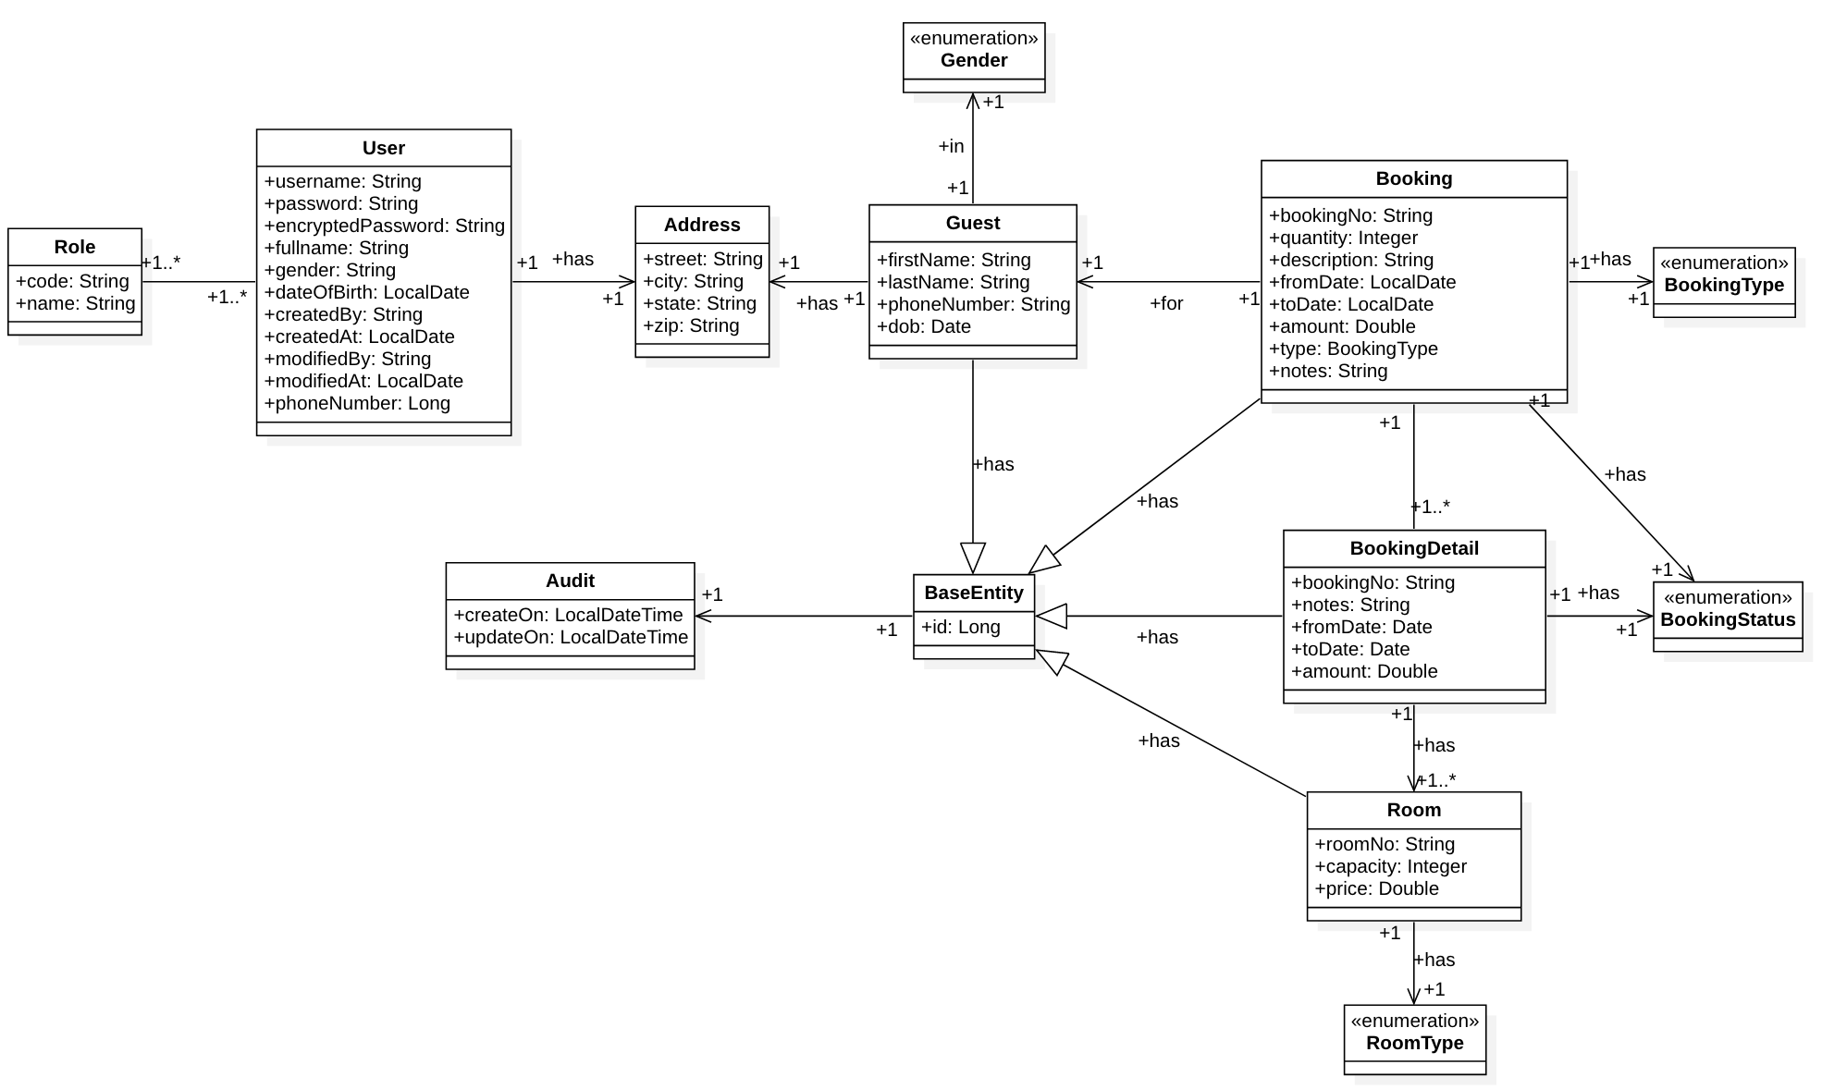
Class Diagram

Slide 8
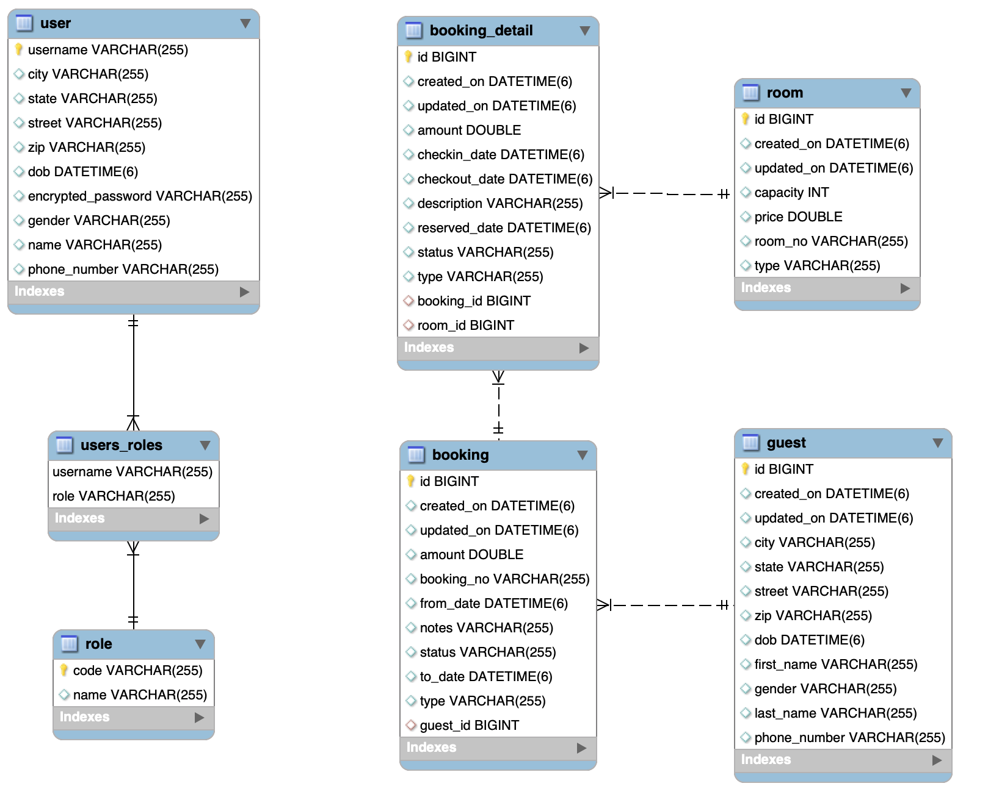
Database Relationship
Notes:
QuickStarter has created an outline to help you get started on your presentation. Some slides include information here in the notes to provide additional topics for you to research.
Summary:
A hotel manager, hotelier, or lodging manager is a person who manages the operation of a hotel, motel, resort, or other lodging-related establishment. Management of a hotel operation includes, but is not limited to management of hotel staff, business management, upkeep and sanitary standards of hotel facilities, guest satisfaction and customer service, marketing management, sales management, revenue management, financial accounting, purchasing, and other functions. The title "hotel manager" or "hotelier" often refers to the hotel's General Manager who serves as a hotel's head executive, though their duties and responsibilities vary depending on the hotel's size, purpose, and expectations from ownership. The hotel's General Manager is often supported by subordinate department managers that are responsible for individual departments and key functions of the hotel operation.

Slide 9
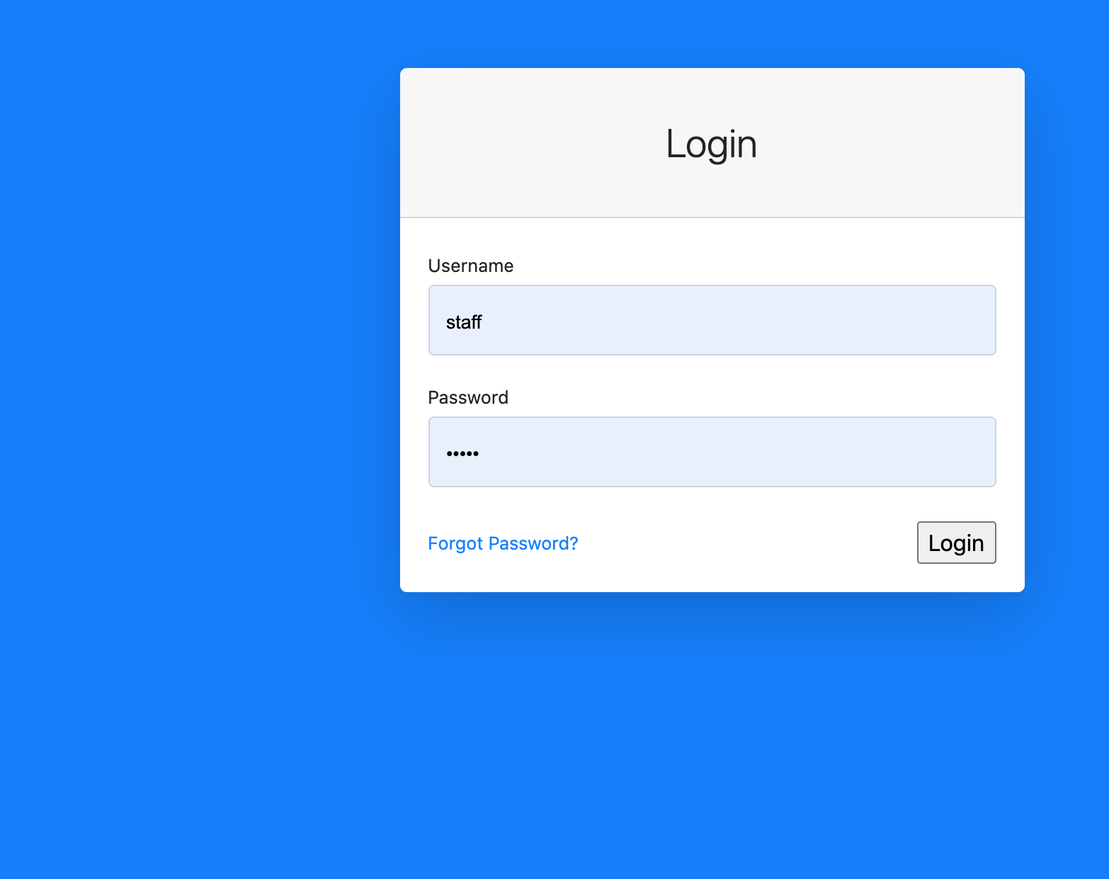
User Case 1: Login
The first screen a user of the system sees is the login screen, which requests ID and password. When the Submit button is clicked, the ID is looked up in the data store. If this ID can be found, and if the password for this ID matches the password submitted, the authorization level is returned. Authorization levels are STAFF, ADMIN, and SUPERADMIN. If login is successful, UI features are made available according to the authorization level of the user.

Slide 10
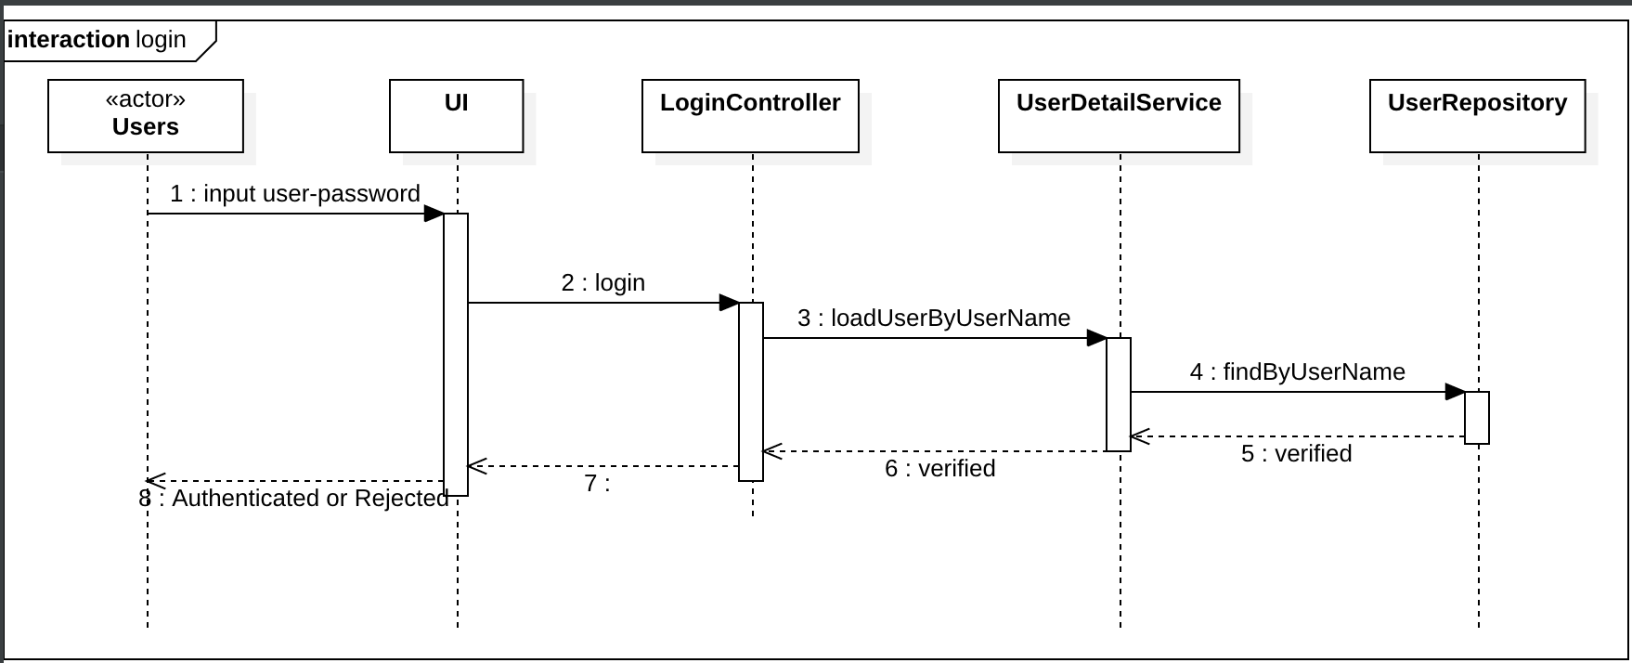
Sequence Diagram

Slide 11
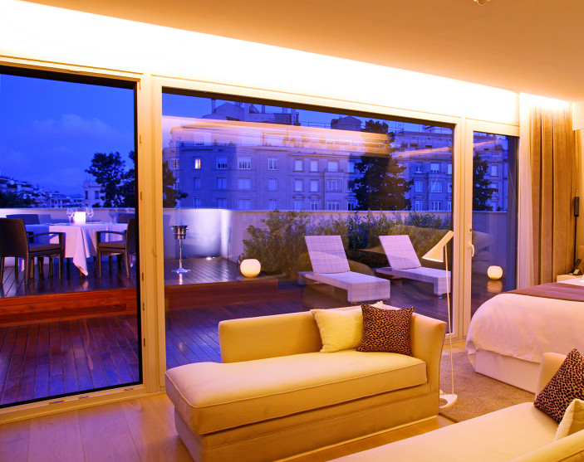
User Case 2: Add New Room
When an Admin selects the option to add a new member, then he is presented with a form with fields: room no, capacity, room type, price. After the data is entered and submitted, it is persisted using the persistence mechanism for this project

Slide 12
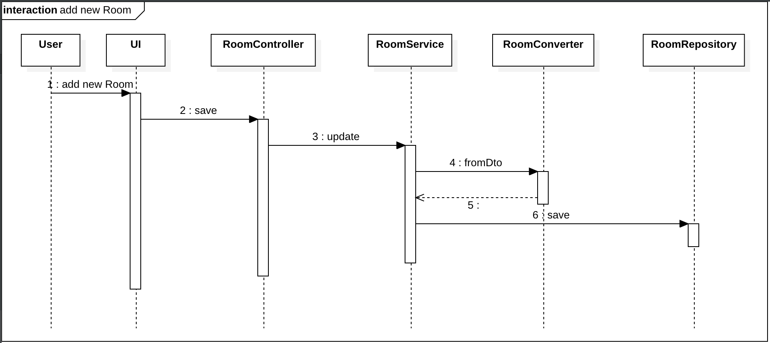
Sequence Diagram

Slide 13
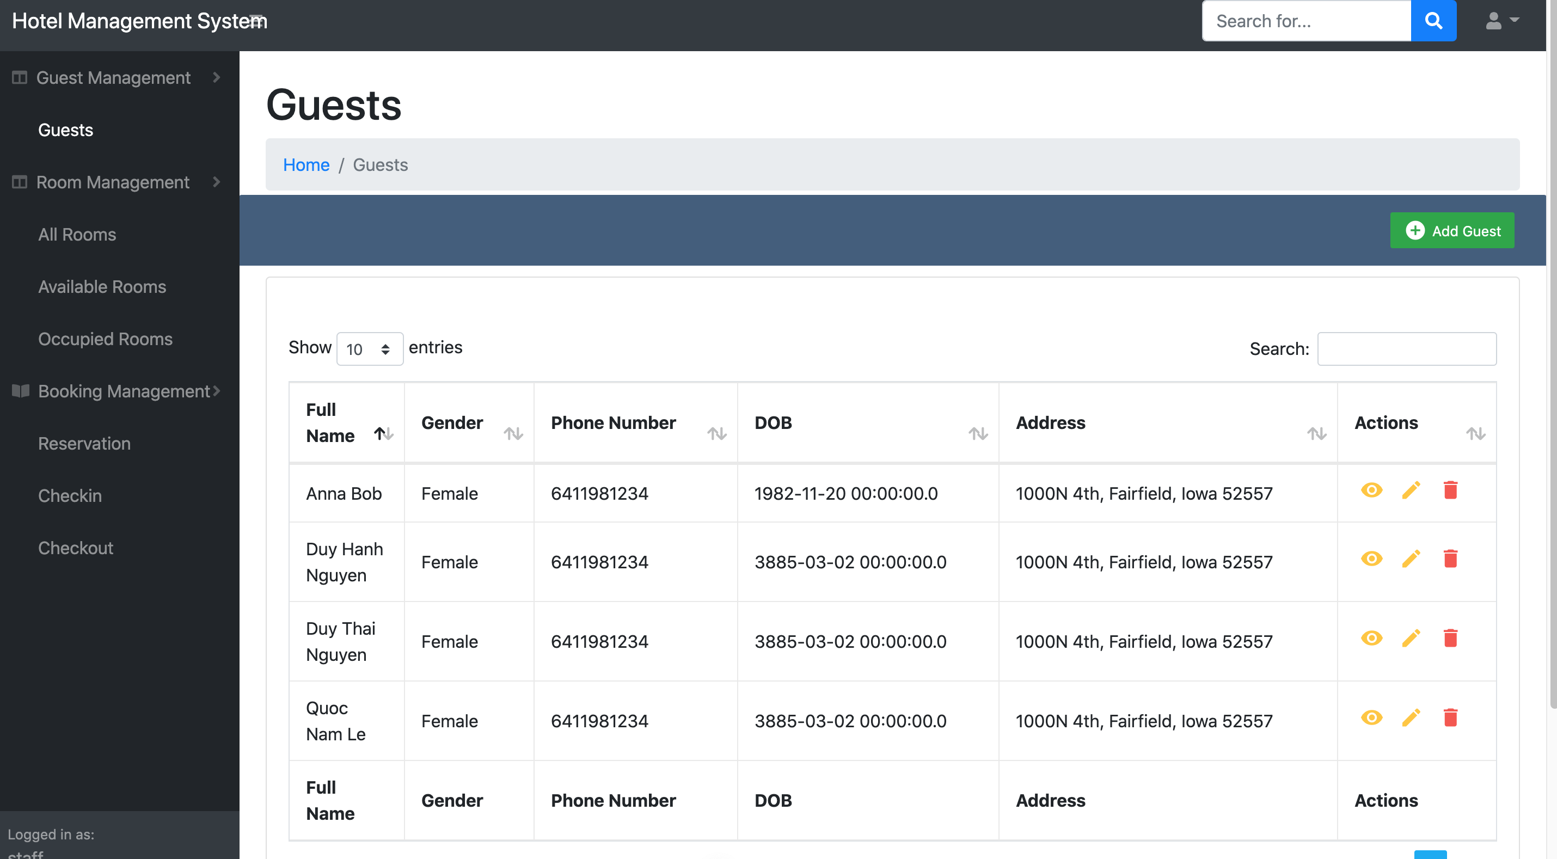
User Case 3: Add new Guest
When an Administrator selects the option to add a new member, then he is presented with a form with fields: guest id, first name, last name, street, city, state, zip, telephone number. After the data is entered and submitted, it is persisted using the persistence mechanism for this project

Slide 14
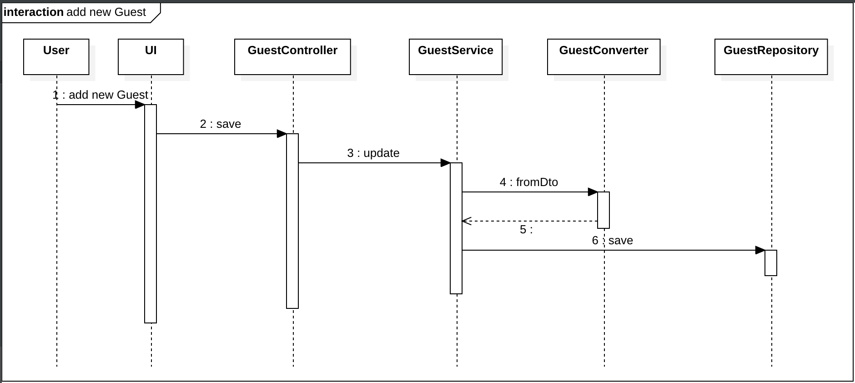
Sequence Diagram

Slide 15
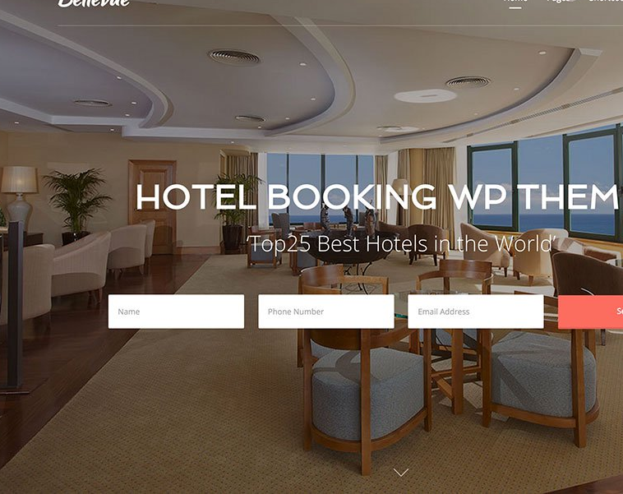
User Case 4: Booking
When a hotel staff selects the option to make room reservation, firstly he creates a new Guest, then make a room reservation. The system shows a form with field number of rooms, number of Guest, fromDate, toDate, etimatedAmount, description. After the data is entered and submitted, it is persisted using the persistence mechanism for this project

Slide 16
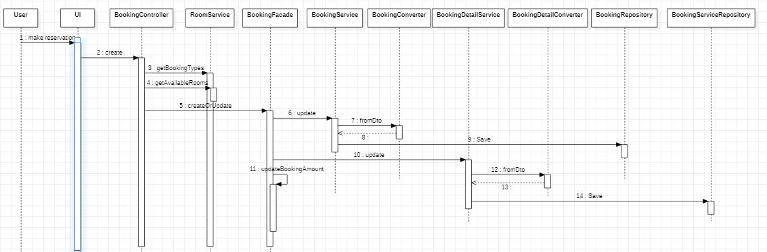
Sequence Diagram

Slide 17
Contents
System Requirement
System Design
Class Diagram
Database Relationship
Sequence Diagrams
System Demo

Slide 18
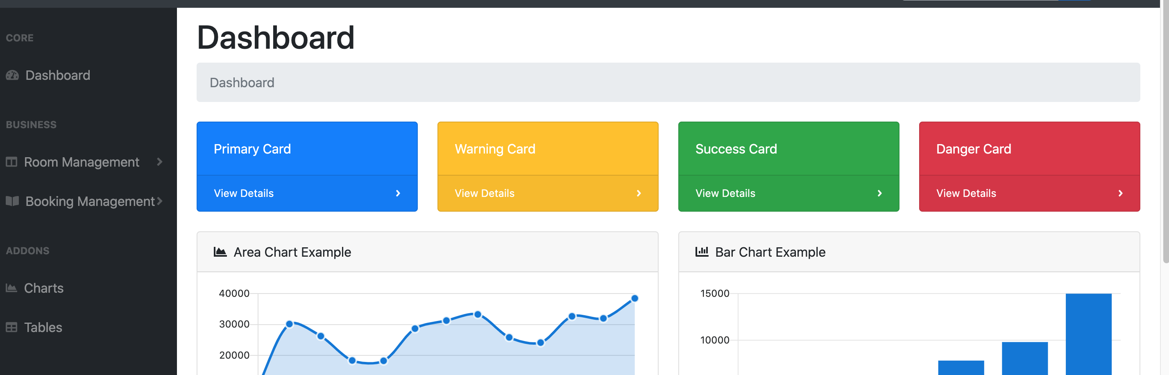
System Demo
Notes:
QuickStarter has created an outline to help you get started on your presentation. Some slides include information here in the notes to provide additional topics for you to research.
Summary:
A hotel manager, hotelier, or lodging manager is a person who manages the operation of a hotel, motel, resort, or other lodging-related establishment. Management of a hotel operation includes, but is not limited to management of hotel staff, business management, upkeep and sanitary standards of hotel facilities, guest satisfaction and customer service, marketing management, sales management, revenue management, financial accounting, purchasing, and other functions. The title "hotel manager" or "hotelier" often refers to the hotel's General Manager who serves as a hotel's head executive, though their duties and responsibilities vary depending on the hotel's size, purpose, and expectations from ownership. The hotel's General Manager is often supported by subordinate department managers that are responsible for individual departments and key functions of the hotel operation.

Slide 19

Demo Process Flow
1 Login
2 Add New Room
3 Add New Guest
4 Create Guest Reservation
5 Create Check-In
6 Create Check-Out

Slide 20
Process Flow
1 Login
2 Add New Room
3 Add New Guest
4 Create Guest Reservation
5 Create Check-In
6 Create Check-Out

Slide 21
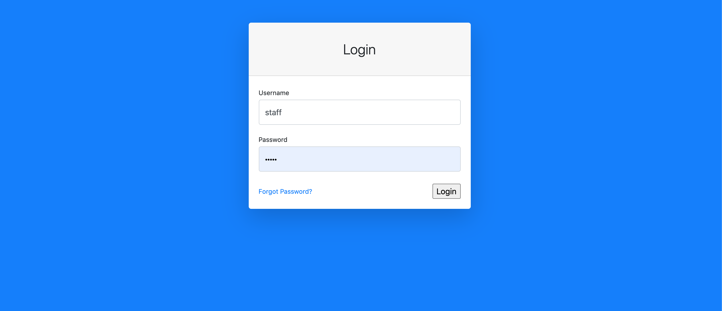
Login Page
Login page show only two fields: Username and Password, and there is button Login to login, a hyperlink Forgot Password for user to reset the password.

Slide 22
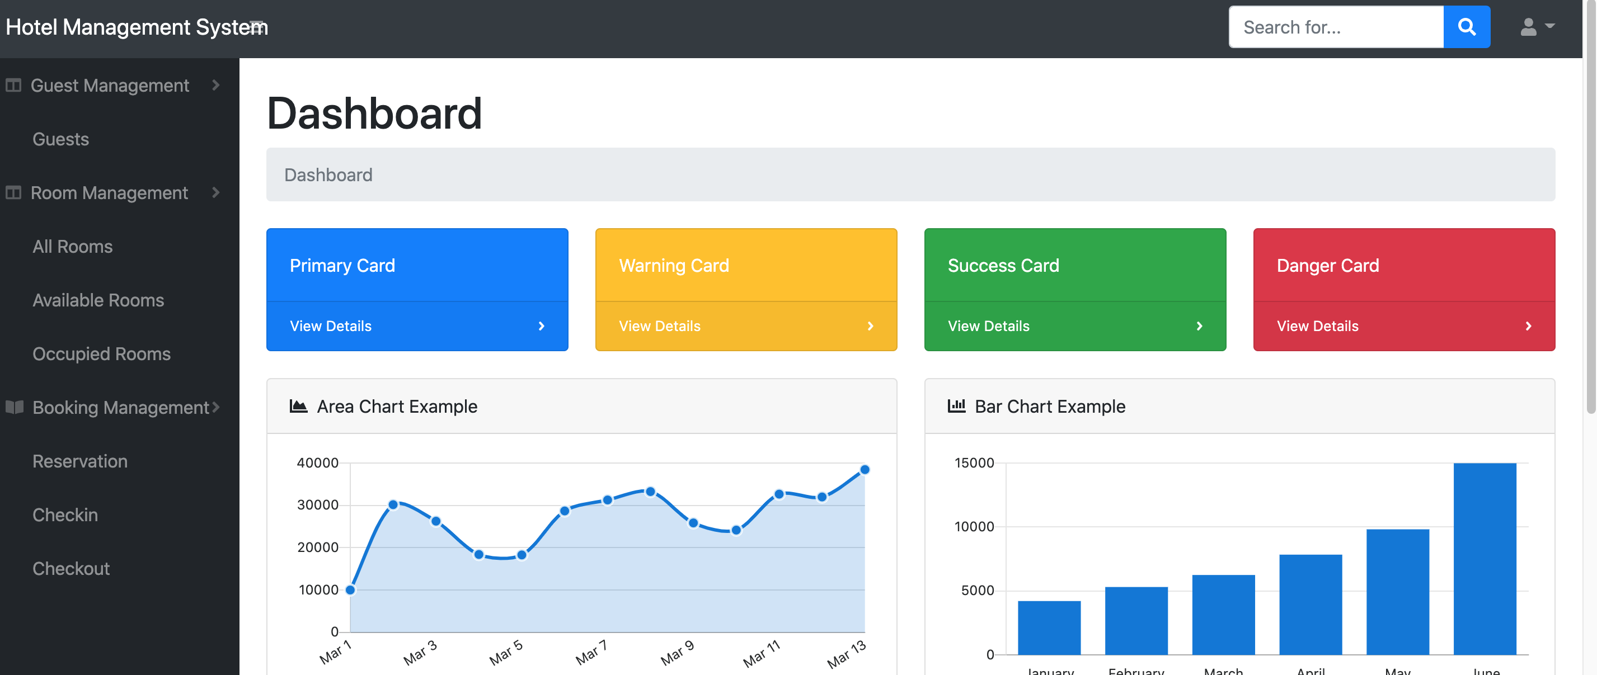
Home screen after login
The left side of home screen shows all menu of the system.
Center Dashboard show all require dashboards that client need to display.
Top of screen has a search field to search for Room, Guest, Booking…

Slide 23
Process Flow
1 Login
2 Add New Room
3 Add New Guest
4 Create Guest Reservation
5 Create Check-In
6 Create Check-Out

Slide 24
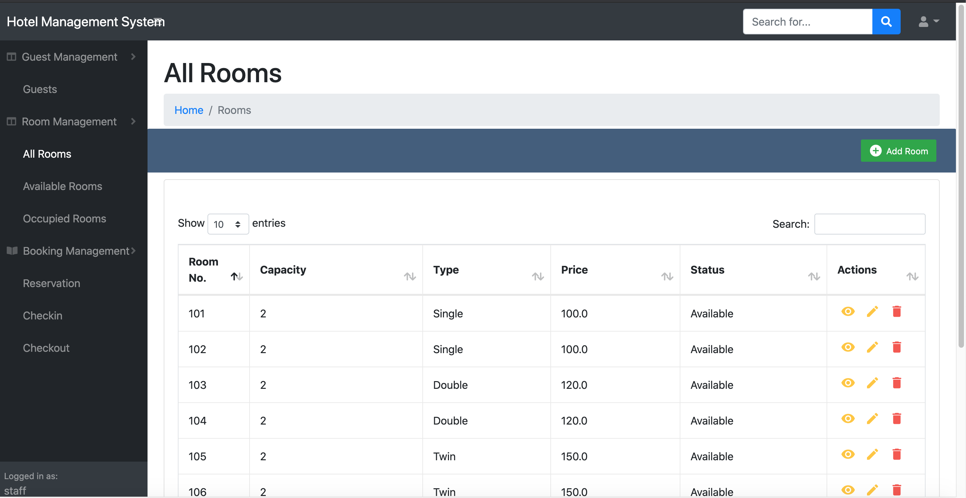
Add New Room
User go to Menu: Room Management > All Rooms, this form will show all rooms and their information, also allow to view, edit and delete room.
There is a green button on the right side to add new Room.

Slide 25
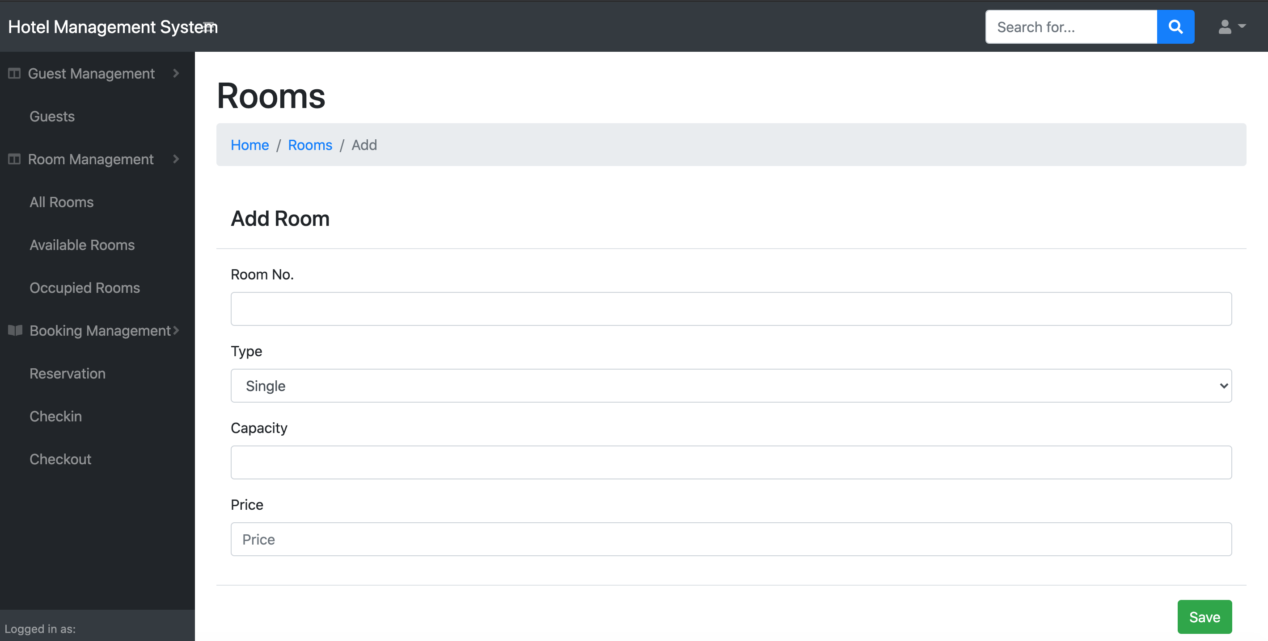
After click add Room button
System navigate to the add Room form, user can input Room No, Type, Capacity and Price of Room before click Save.
If user input the same Room No, system will show an error.
After fill all information, user click save to add room, system will automatic navigate back to Room form.

Slide 26
View Room after add New Room
User click to Home hyperlink to go back to Home screen.

Slide 27
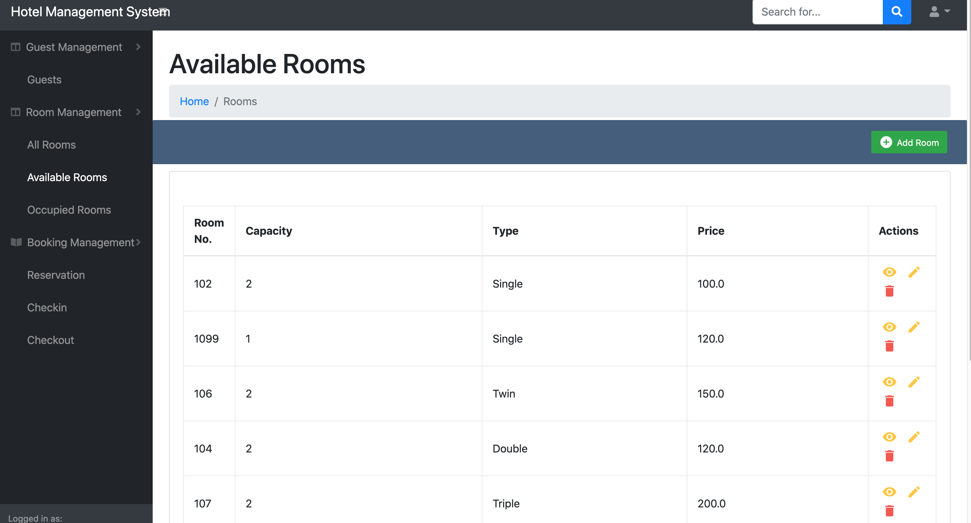
View Available Room
User go to Room Management > Available Room to see the list of available room that can be booked.

Slide 28
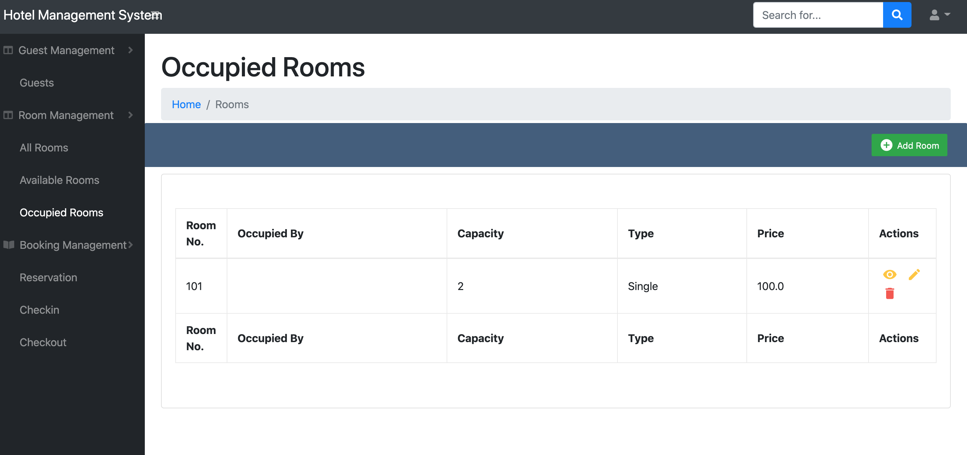
View Available Room
User go to Room Management > Occupied Rooms to see the list of rooms that were booked .

Slide 29
Process Flow
1 Login
2 Add New Room
3 Add New Guest
4 Create Guest Reservation
5 Create Check-In
6 Create Check-Out

Slide 30
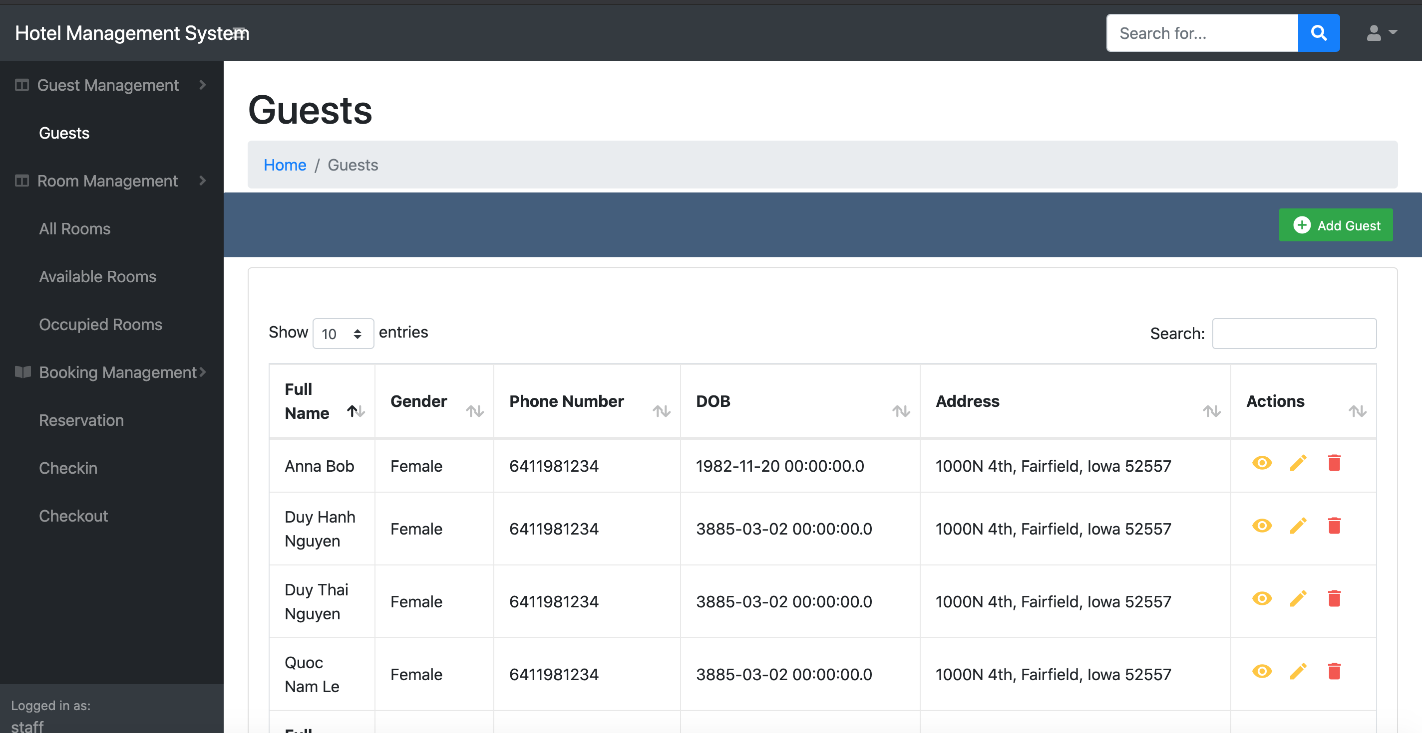
Add New Guest
User go to Menu: Room Management > Guest, this form will show all Guests and their information, also allow to view, edit and delete Guest.
There is a green button on the right side to add new Guest.

Slide 31
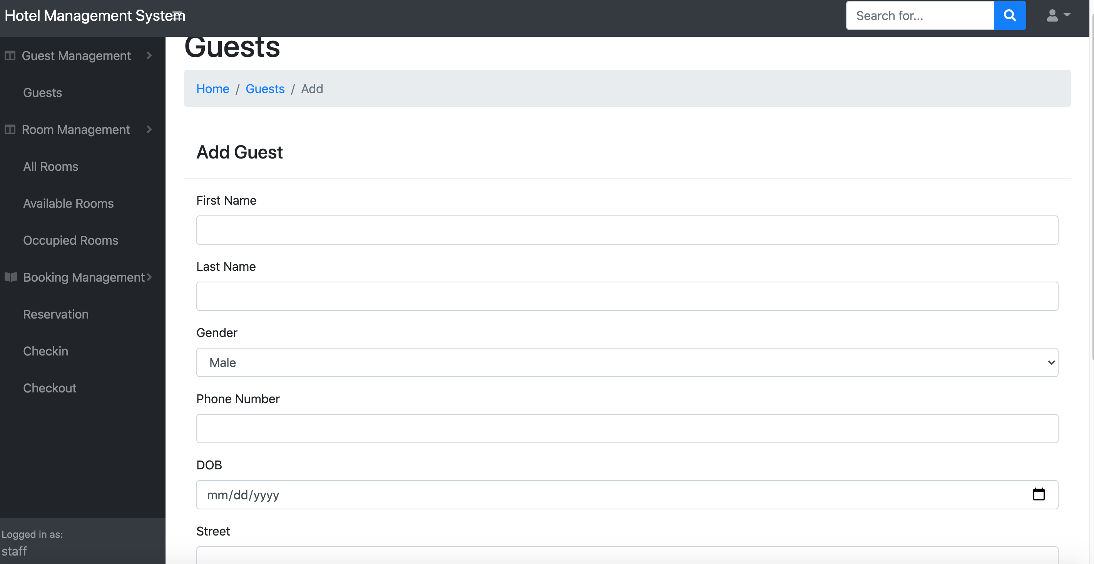
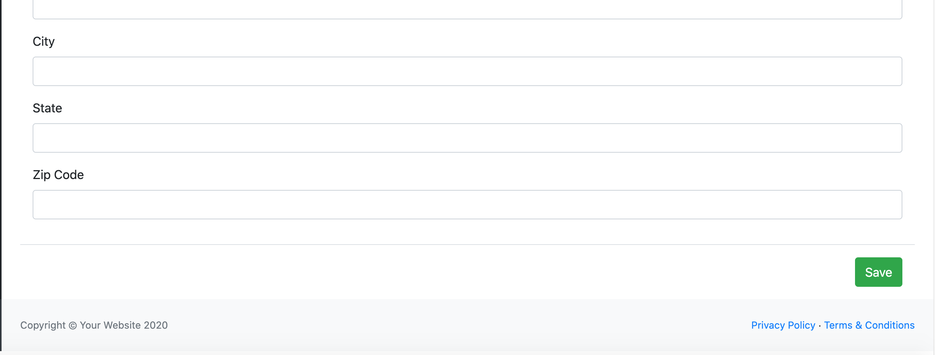
After click add Guest button
System navigate to the add Guest form, user can input Guest First Name, Last Name, Gender, Phone Number, DOB, Street, City, State, Zip Code before click Save.
After fill all information, user click save to add Guest, system will automatic navigate back to Guest form.

Slide 32
After click add Save button
User click to Home hyperlink to go back to Home screen

Slide 33
Process Flow
1 Login
2 Add New Room
3 Add New Guest
4 Create Guest Reservation
5 Create Check-In
6 Create Check-Out

Slide 34
Create Guest Reservation
From the Guests form, user click ”Eye” button in each Guest to go Guest detail form.

Slide 35
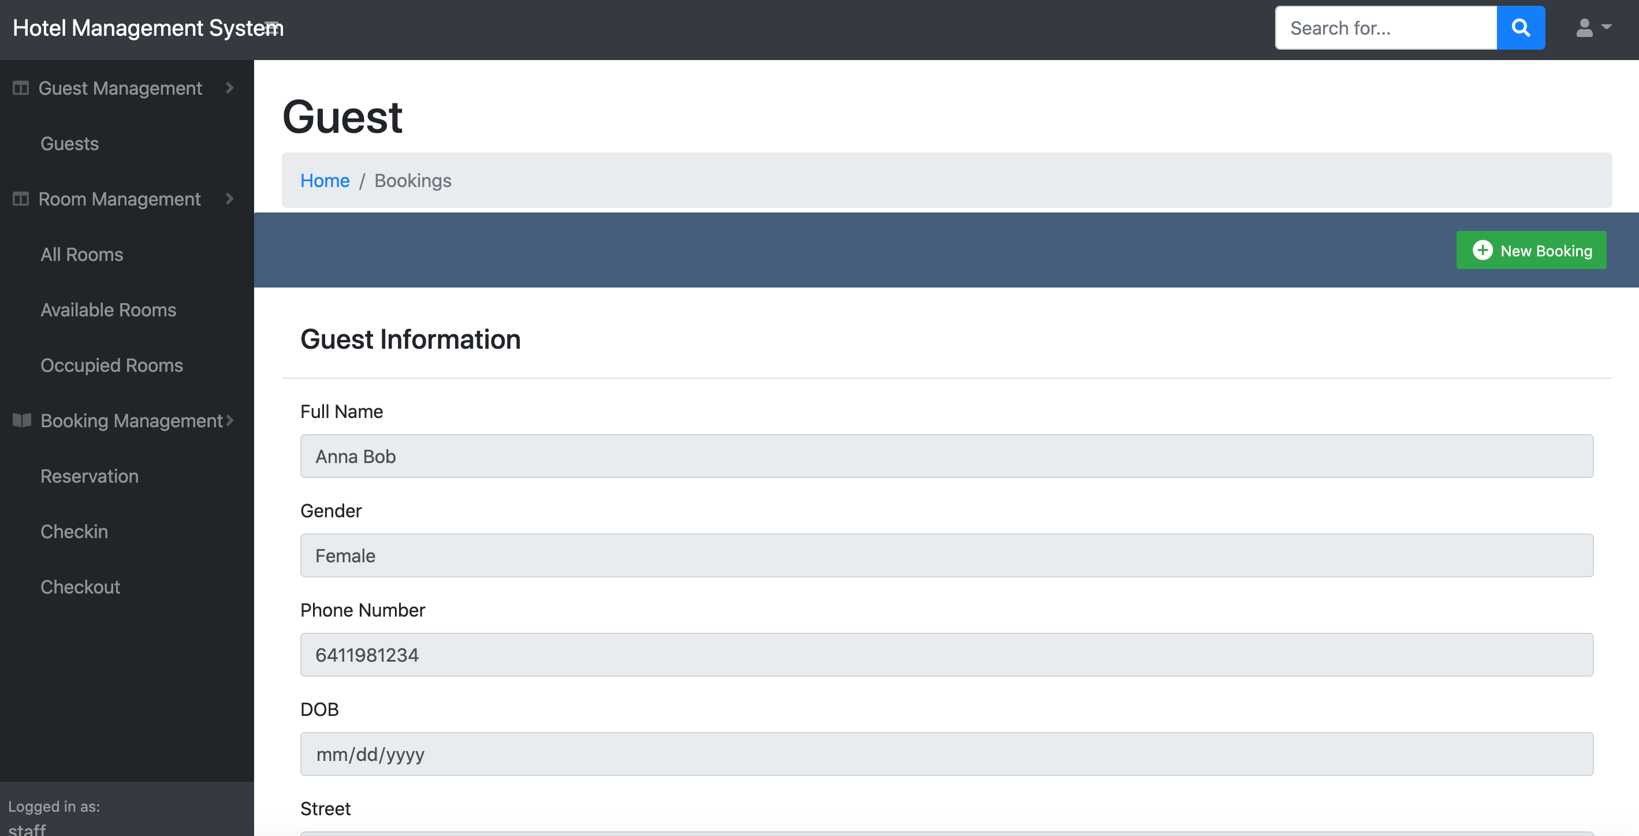
Create Guest Reservation
In the Guest detail form, there is a green Button: New Booking. User click to this to create new Booking.

Slide 36
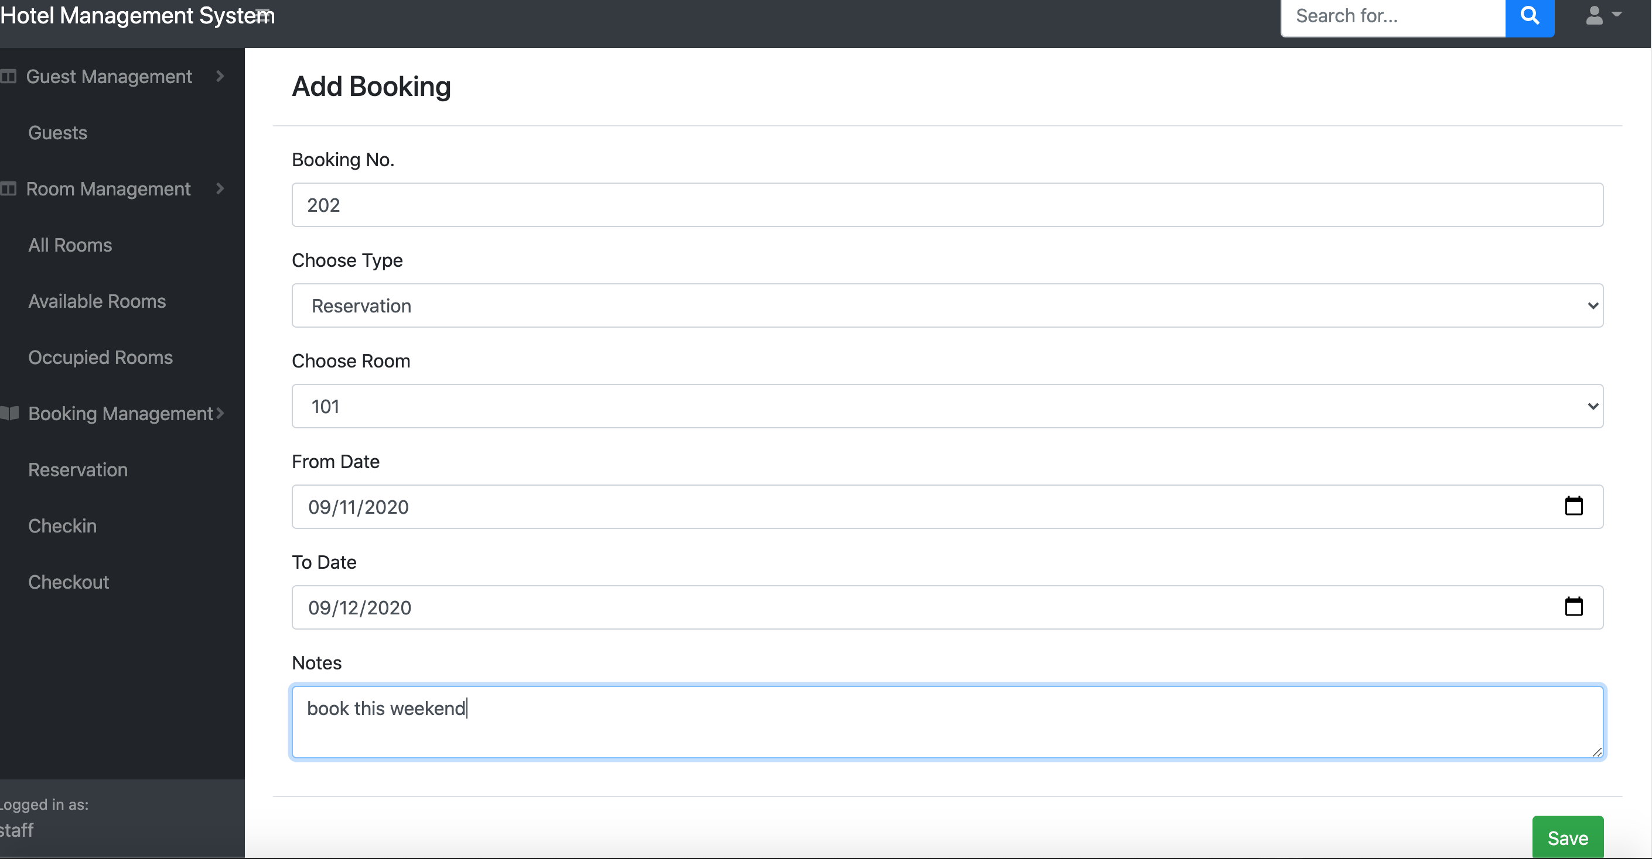
Create Guest Reservation
System navigate to the Add Booking form, user can input Booking No, Type (Reservation, Checkin, Checkout)Room number, from booking date, to booking date before click Save.
After fill all information, user click save to add new Booking, system will automatic navigate Booking Detail form.

Slide 37
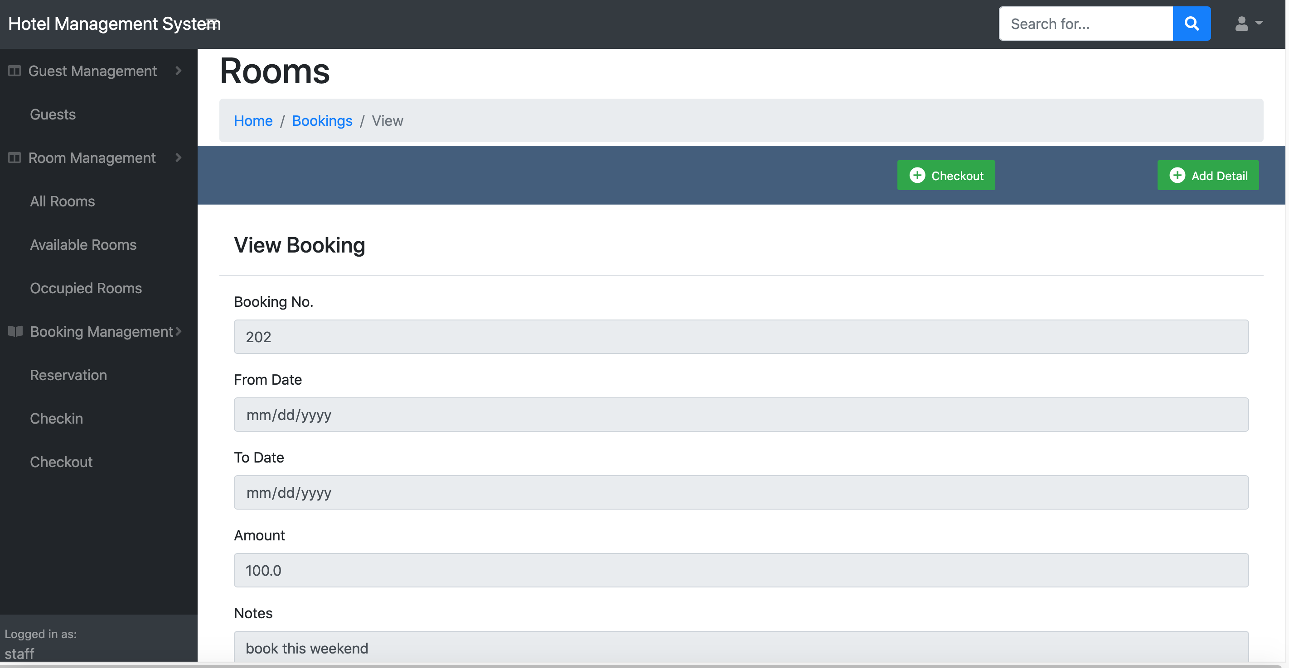
Create Guest Reservation
In the booking detail form, there is 2 button: Checkout for user to check out, and Add detail for user to add booking detail information. User click to Add Detail to add booking detail information.

Slide 38
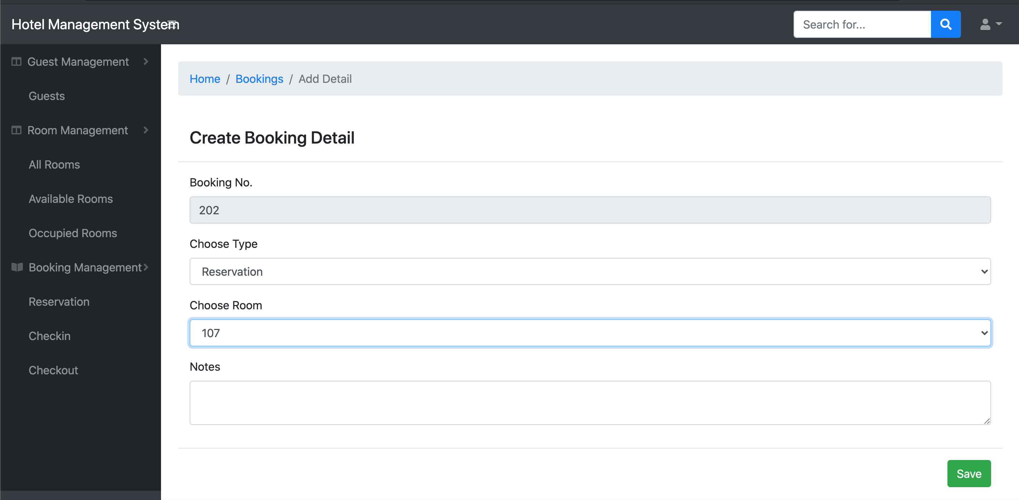
Create Guest Reservation
After click Add Detail, user will be navigate to Create Booking Detail form. In here, user can add Rooms to the Booking (1 Booking can have many room), then user click Save button to navigate back to Booking form

Slide 39
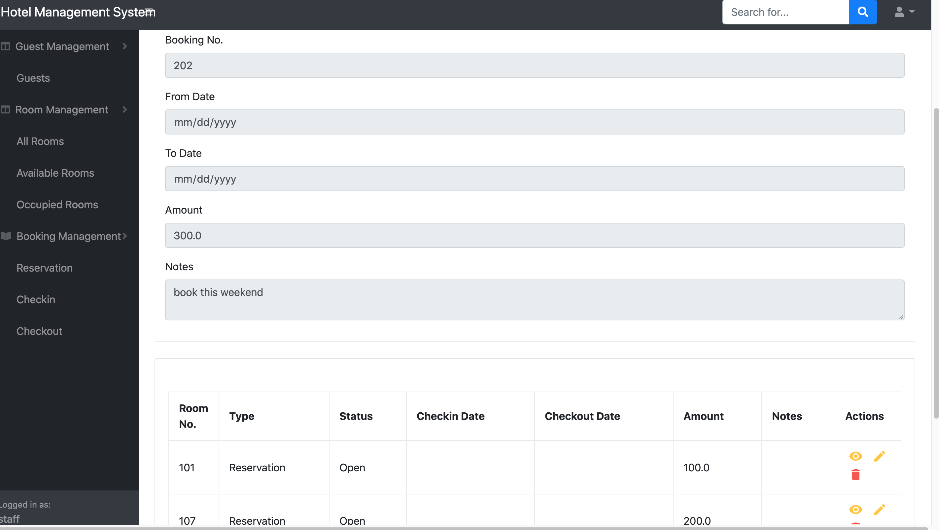
Create Guest Reservation
In the Booking form, roll down user will see list of Room added to this booking. User can even add more booking detail or just click home to go back to Home screen.

Slide 40
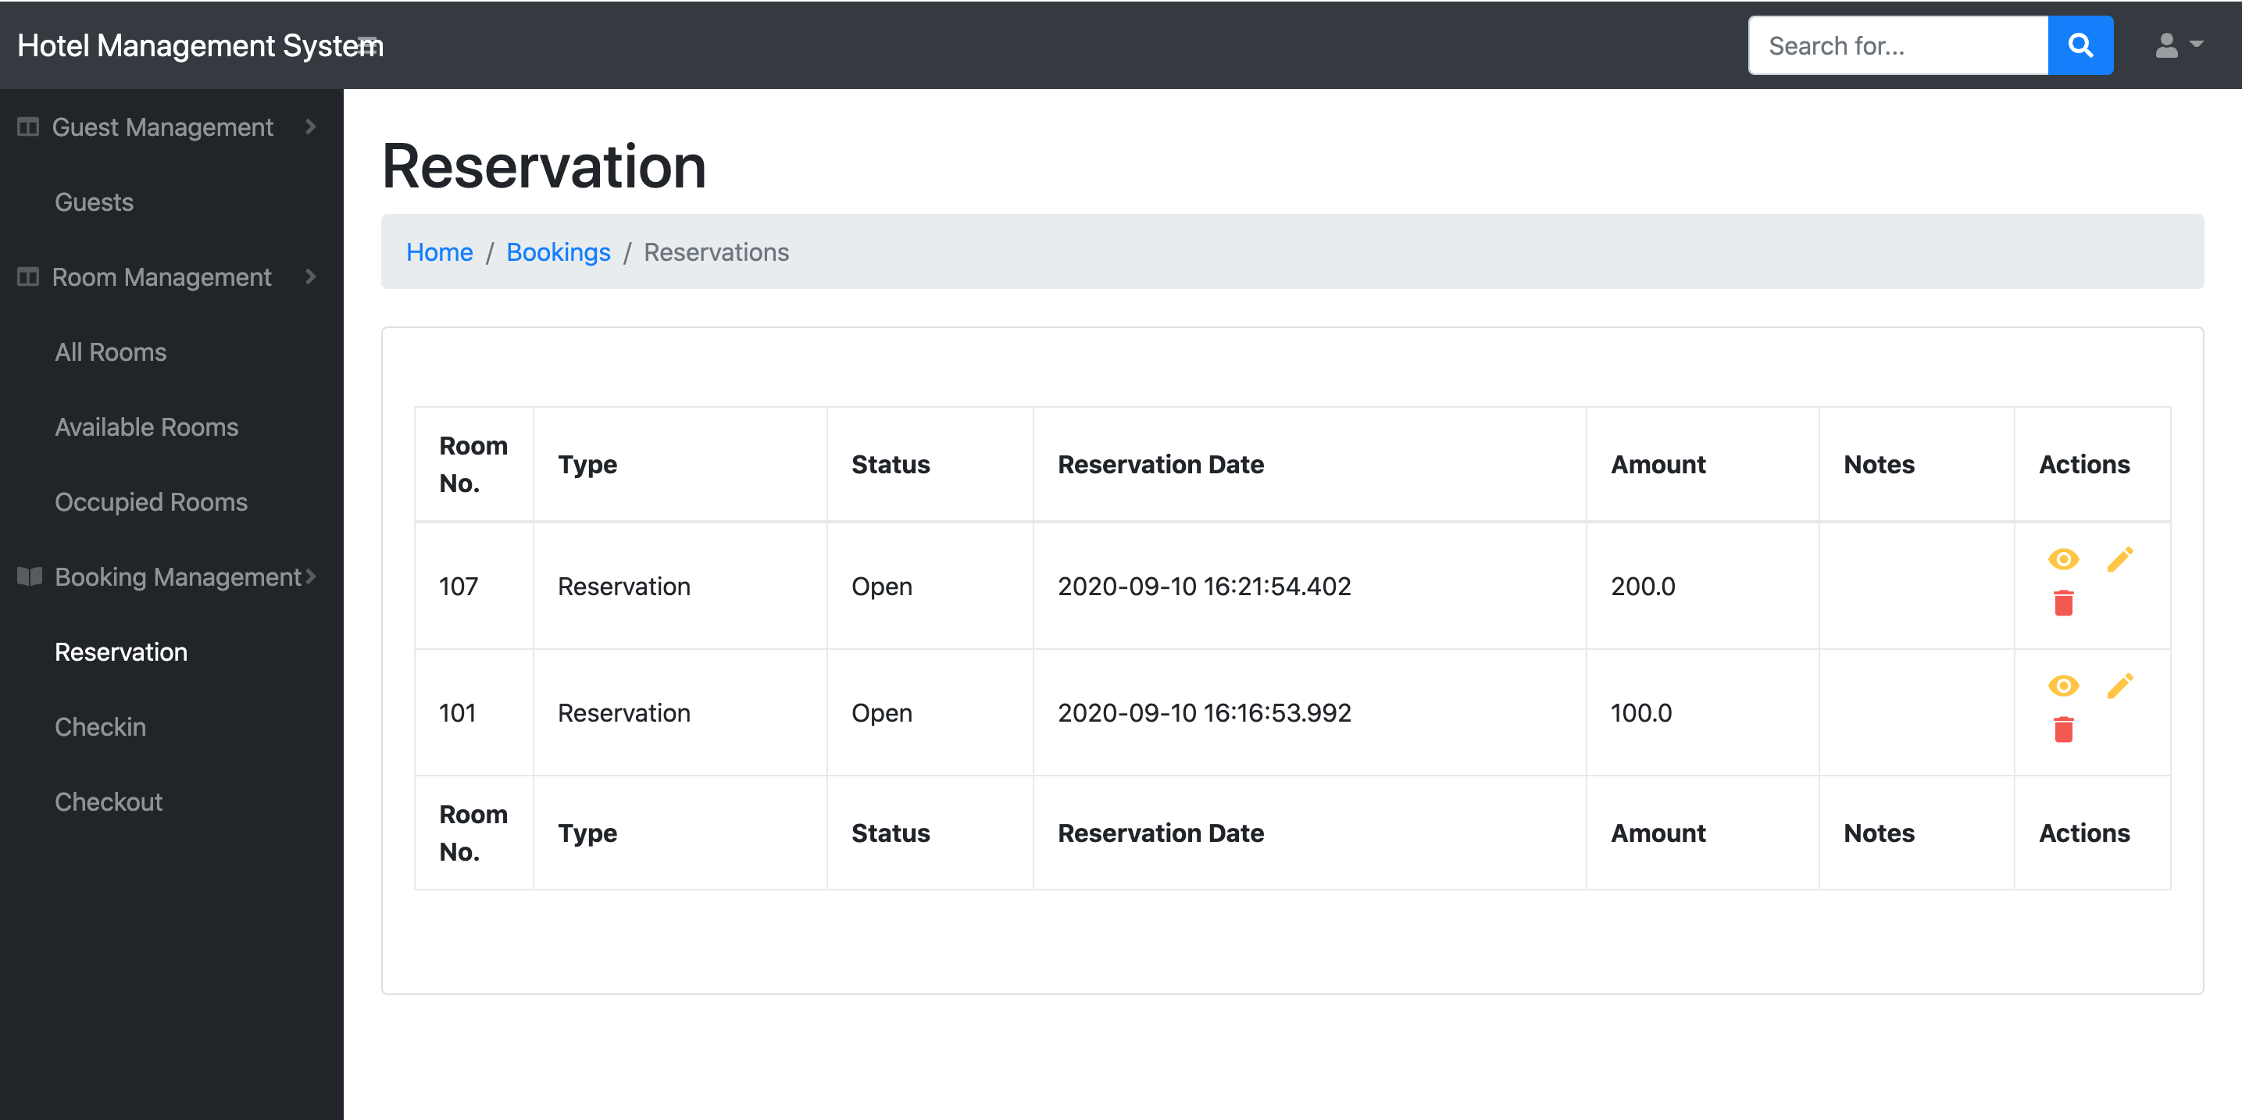
View Guest Reservation
After created booking, user can go to Booking Management > Reservation form from the left menu to see all reservation.
User can also view, edit, delete from this form if needed.

Slide 41
Process Flow
1 Login
2 Add New Room
3 Add New Guest
4 Create Guest Reservation
5 Create Check-In
6 Create Check-Out

Slide 42
Create Check In
At the Reservation form,
User click to edit button. System will navigate user to the edit reservation form.

Slide 43
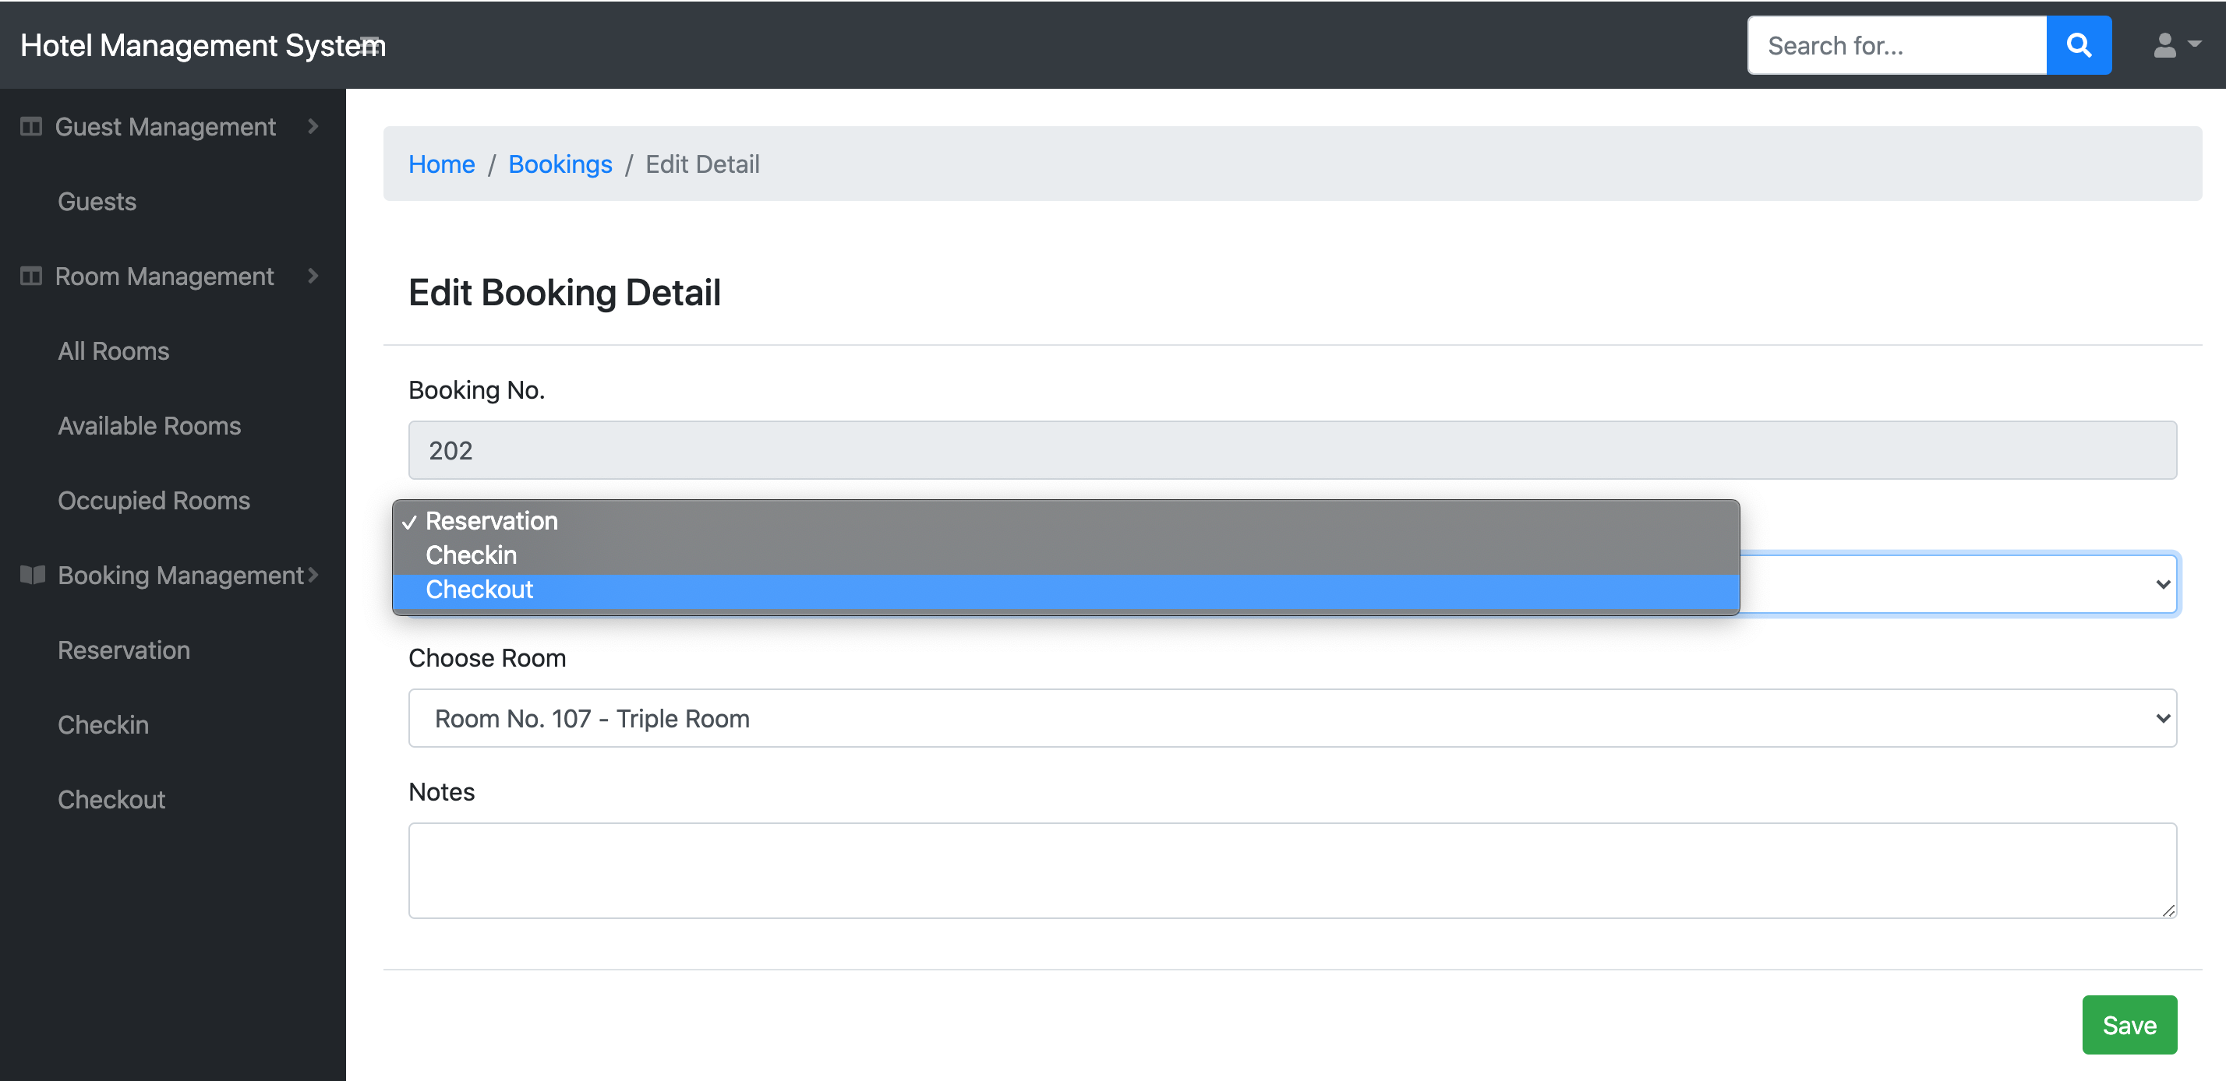
Create Check In
For check in Guest, User simply change the Type of Booking from Reservation to Check in. Then click Save.

Slide 44
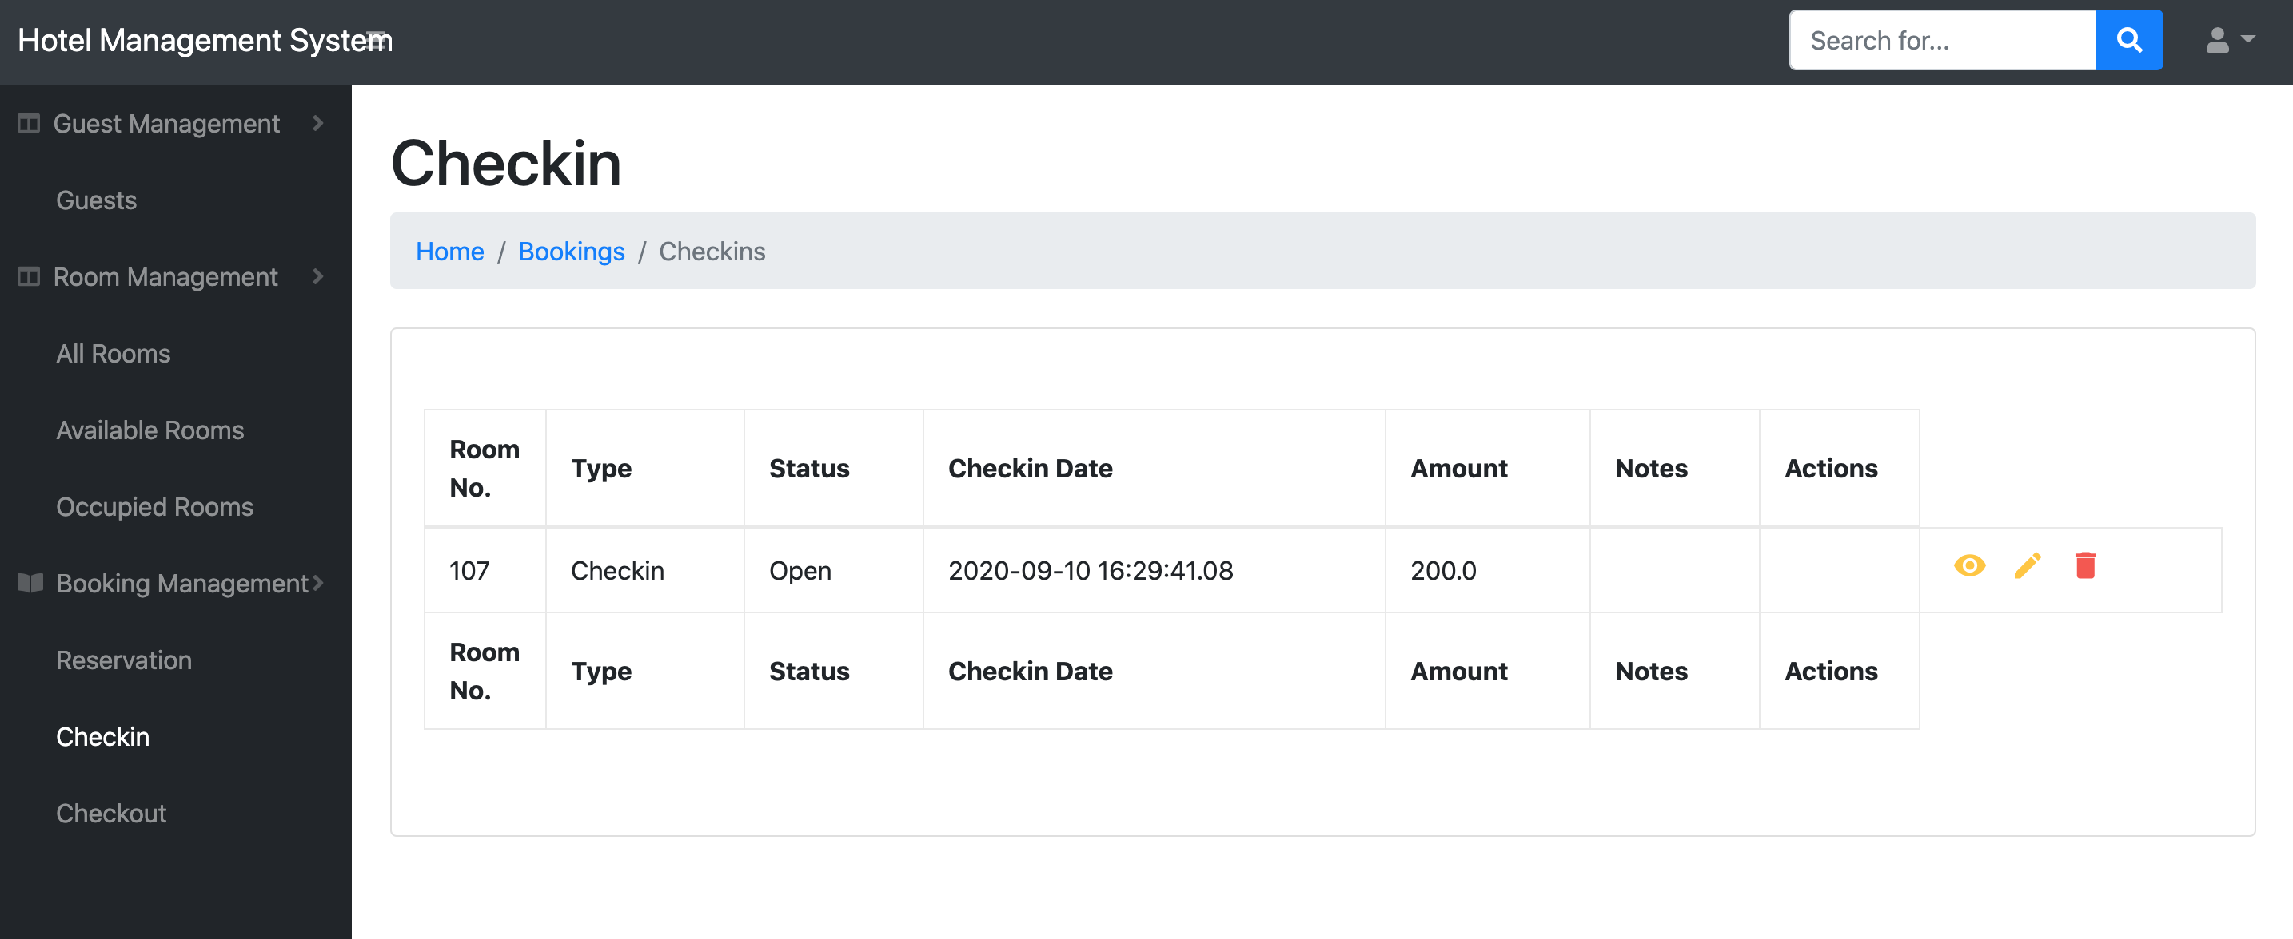
View Check In
Now user can go to Booking Management > Checkin to view all Checkin Records.

Slide 45
Process Flow
1 Login
2 Add New Room
3 Add New Guest
4 Create Guest Reservation
5 Create Check-In
6 Create Check-Out

Slide 46
Create Check Out
At the Reservation form, or Check In form
User click to edit button. System will navigate user to the edit reservation form.

Slide 47
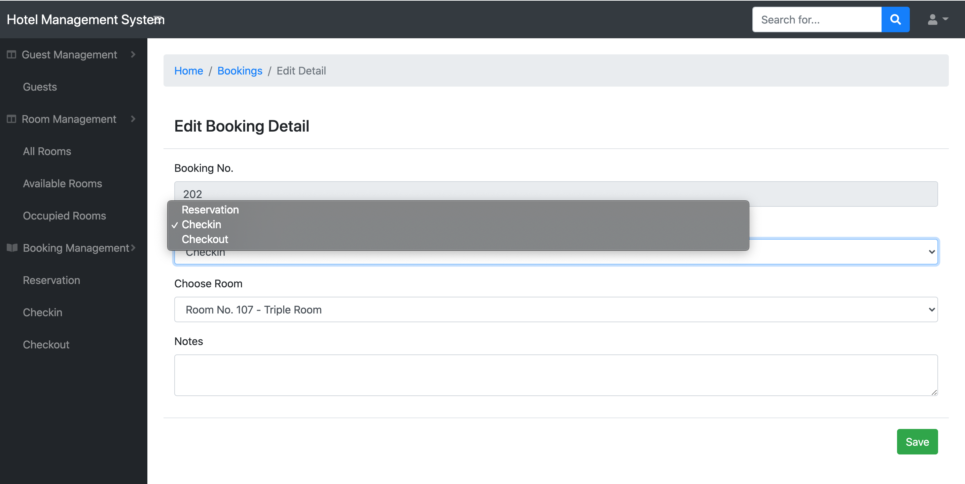
Create Check Out
For check out Guest, User simply change the Type of Booking from Checkin to Check out. Then click Save.

Slide 48
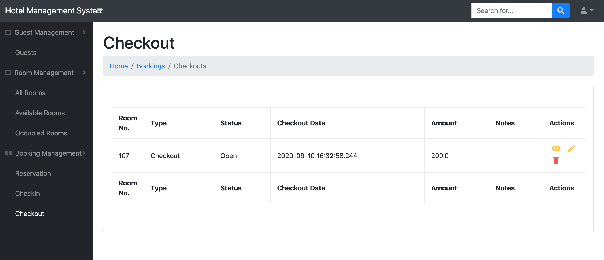
View Check Out
Now user can go to Booking Management > Checkout to view all Checkout Records

Slide 49
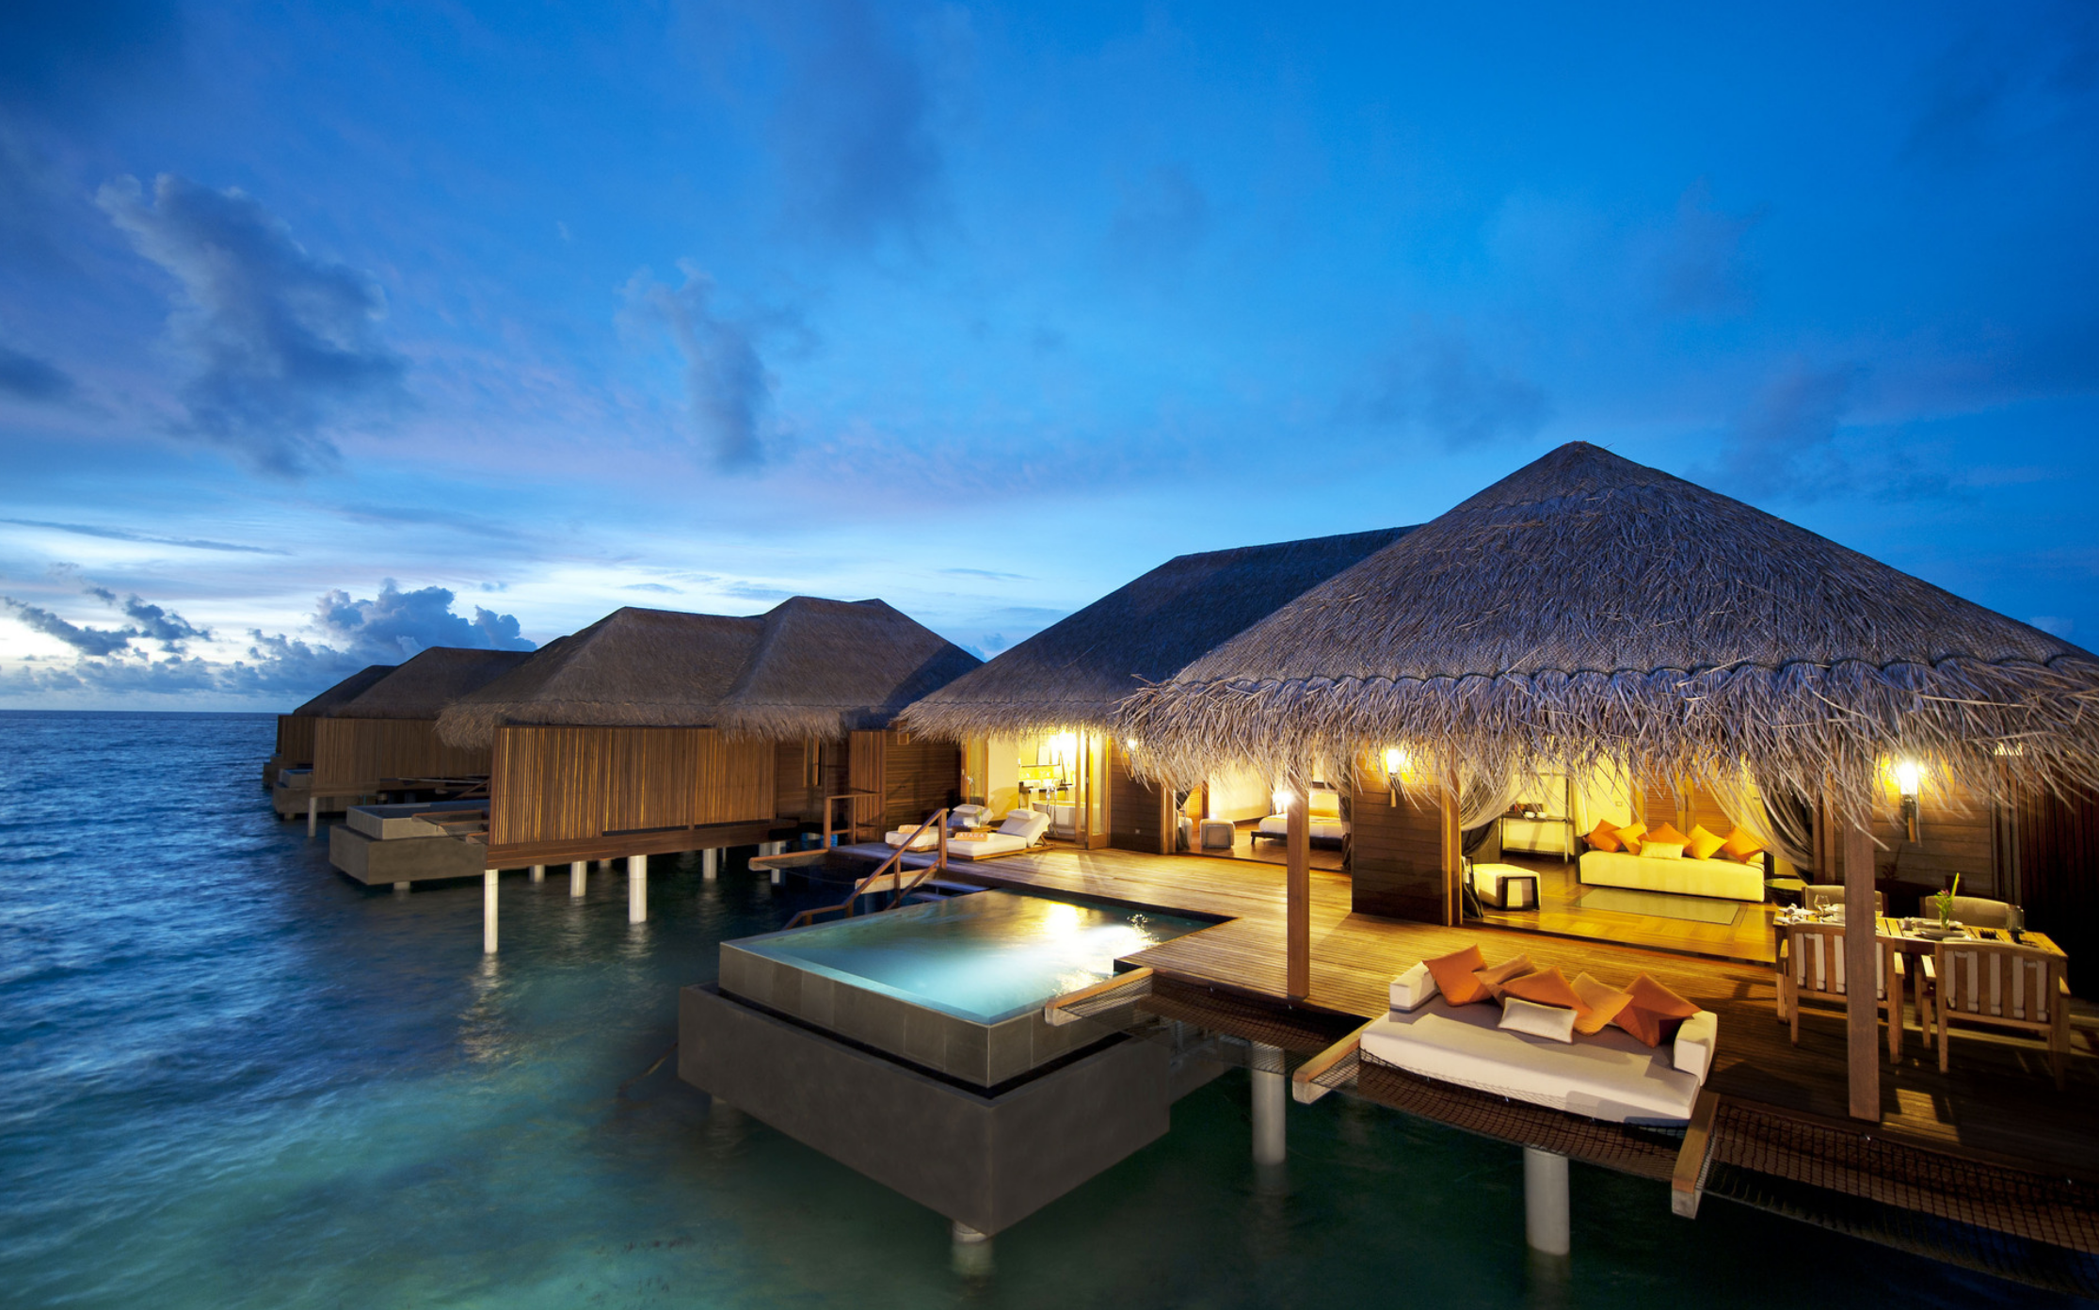
Thank you

